Slide 1
Nucleotide Biosynthesis
(Biosynthesis of Purines & Pyrimidines)
By
Assist. Prof, Dr. Ali Aldeewan

Slide 2
Pyrimidines and Purines
In order to understand the structure and properties of DNA and RNA, we need to look at their structural components.
We begin with certain heterocyclic aromatic compounds called pyrimidines and purines.

Slide 3
Pyrimidines and Purines
In order to understand the structure and properties of DNA and RNA, we need to look at their structural components.
We begin with certain heterocyclic aromatic compounds called pyrimidines and purines.

Slide 4
Nucleosides
The classical structural definition is that a nucleoside is a pyrimidine or purine N-glycoside of D-ribofuranose or 2-deoxy-D-ribofuranose.
Informal use has extended this definition to apply to purine or pyrimidine N-glycosides of almost any carbohydrate.
The purine or pyrimidine part of a nucleoside is referred to as a purine or pyrimidine base.

Slide 5
Nucleotides
Nucleotides are phosphoric acid esters of nucleosides.

Slide 6
Adenosine 5'-Monophosphate (AMP)
Adenosine 5'-monophosphate (AMP) is also called 5'-adenylic acid.
NH₂
N
N
O
N
N
HO
P
OCH₂
5'
O
4'
1'
HO
3'
2'
HO
OH

Slide 7
Adenosine Diphosphate (ADP)
NH₂
N
N
O
O
N
N
HO
P
O
P
OCH₂
O
HO
HO
HO
OH

Slide 8
Adenosine Triphosphate (ATP)
NH₂
N
N
O
O
O
N
N
HO
P
O
P
O
P
OCH₂
O
HO
HO
HO
HO
OH

Slide 9
Adenosine 3'-5'-Cyclic Monophosphate (cAMP)
Cyclic AMP is an important regulator of many biological processes.
NH₂
N
N
N
N
CH₂
O
O
O
P
O
OH
HO

Slide 10
Nucleic Acids
Nucleic acids are polymeric nucleotides (polynucleotides).
5' Oxygen of one nucleotide is linked to the 3' oxygen of another.

Slide 11
Fig. 27.22
A section of a polynucleotide chain.

Slide 12
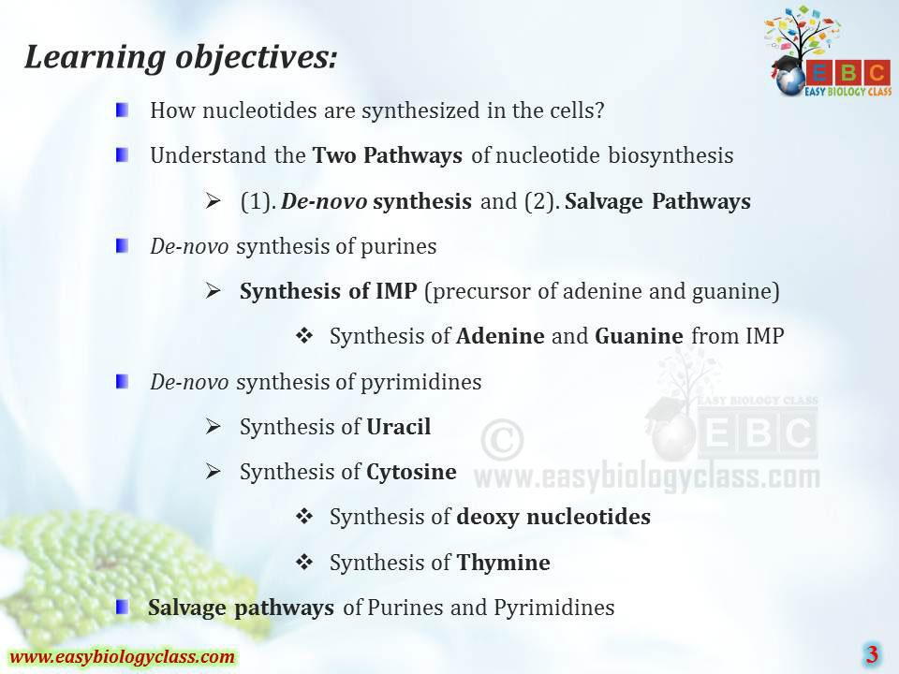

Slide 13
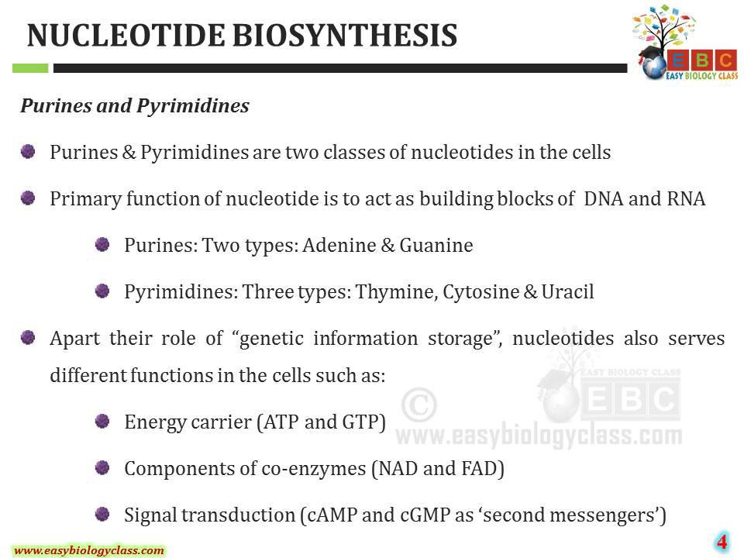

Slide 14
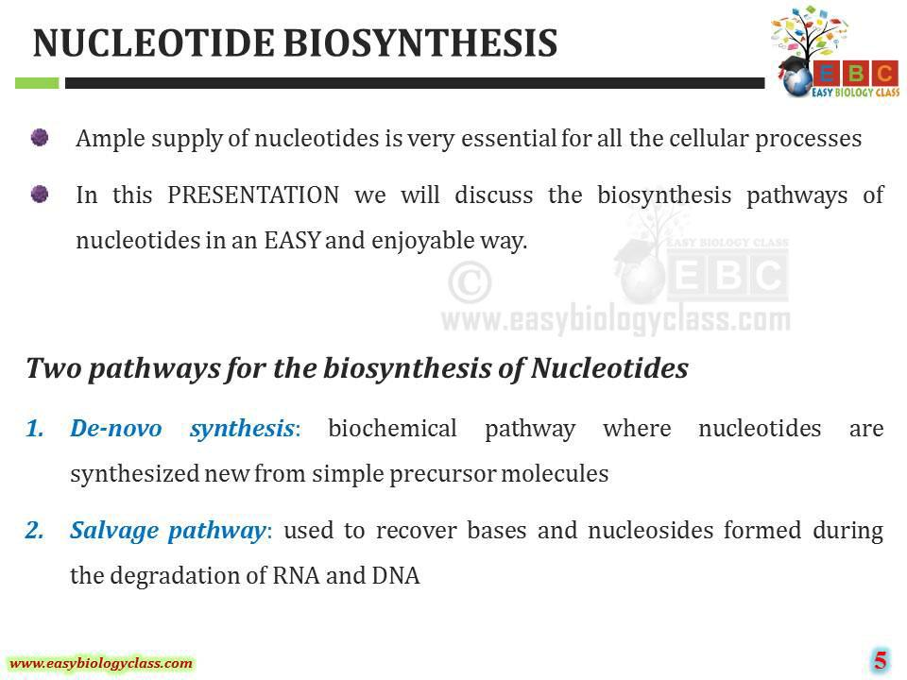

Slide 15
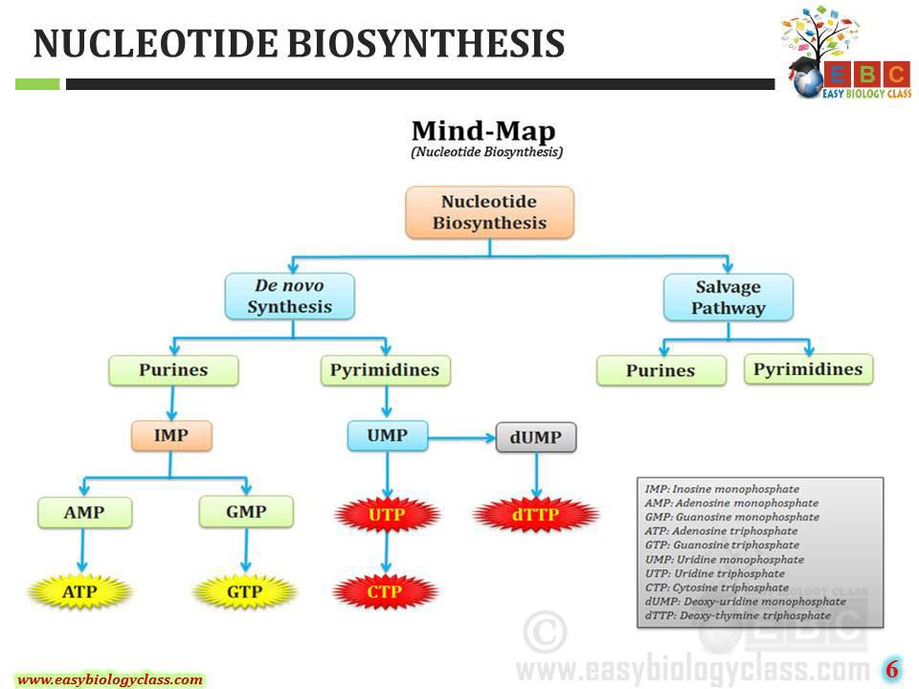

Slide 16
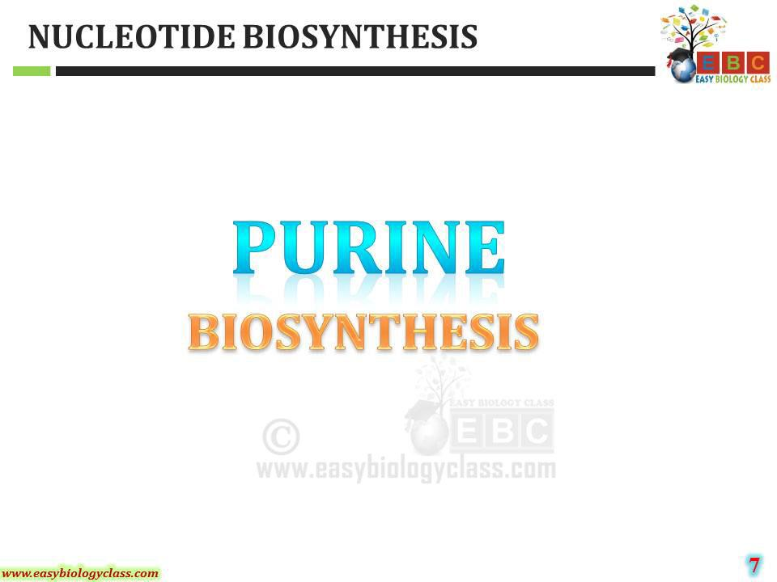

Slide 17
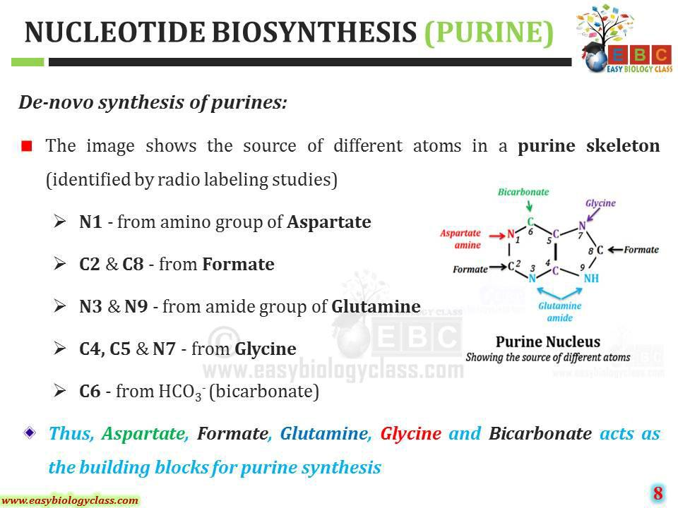

Slide 18
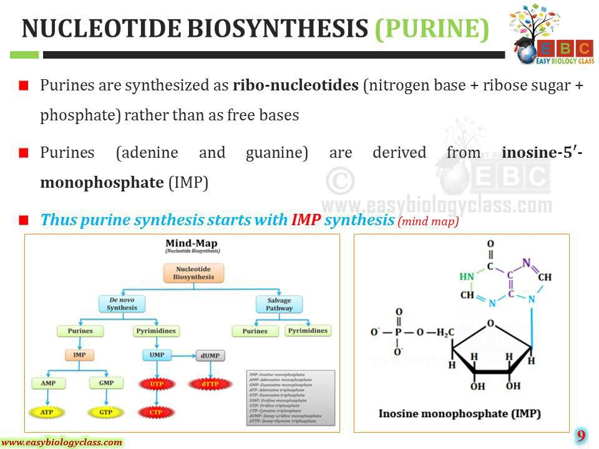

Slide 19
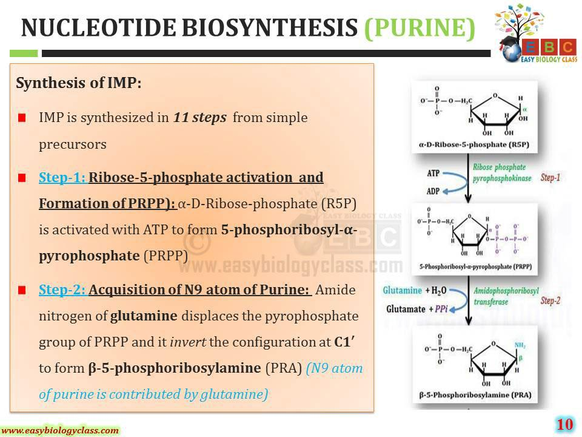

Slide 20
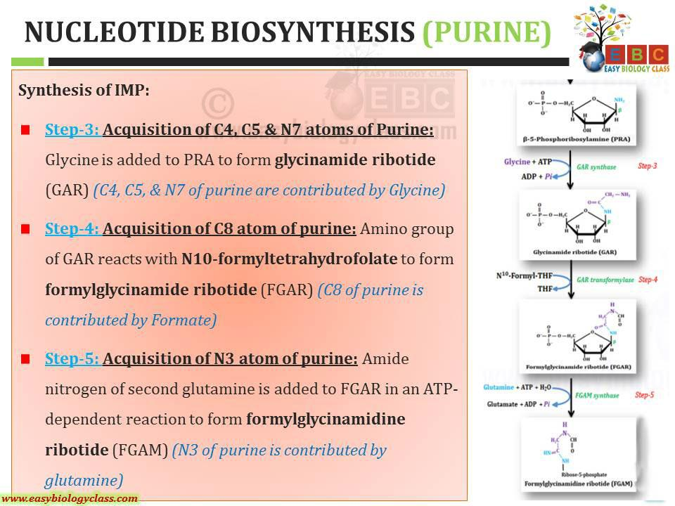

Slide 21
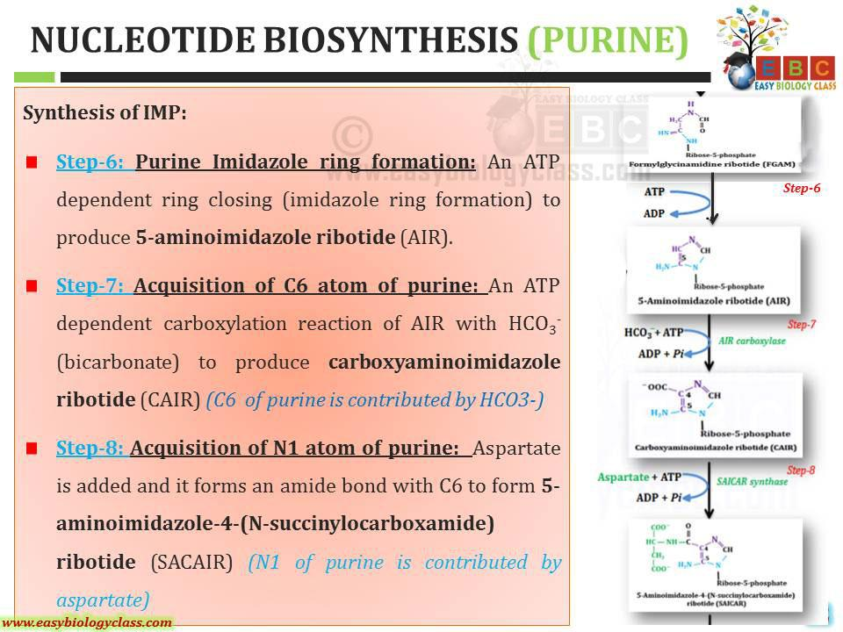

Slide 22
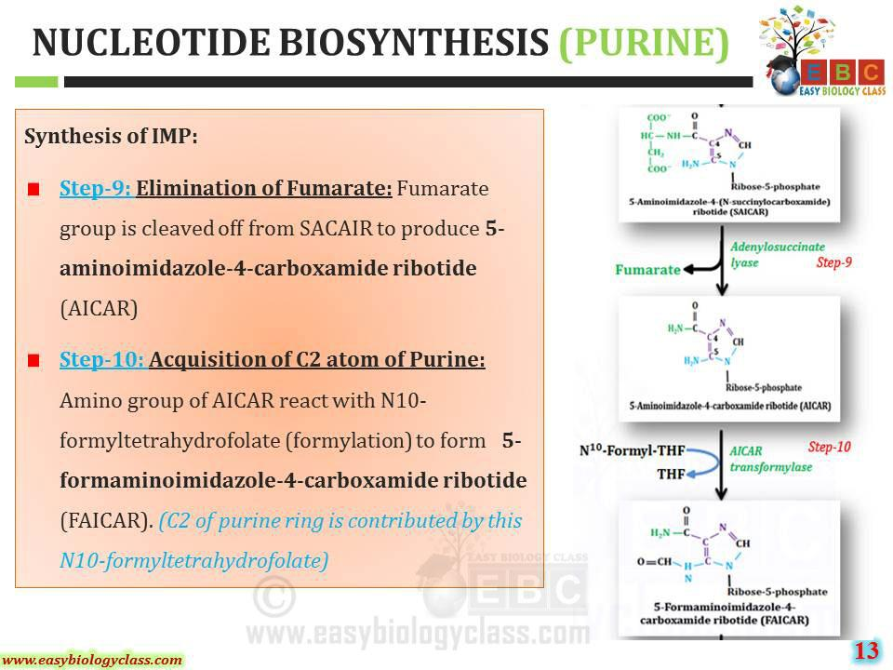

Slide 23
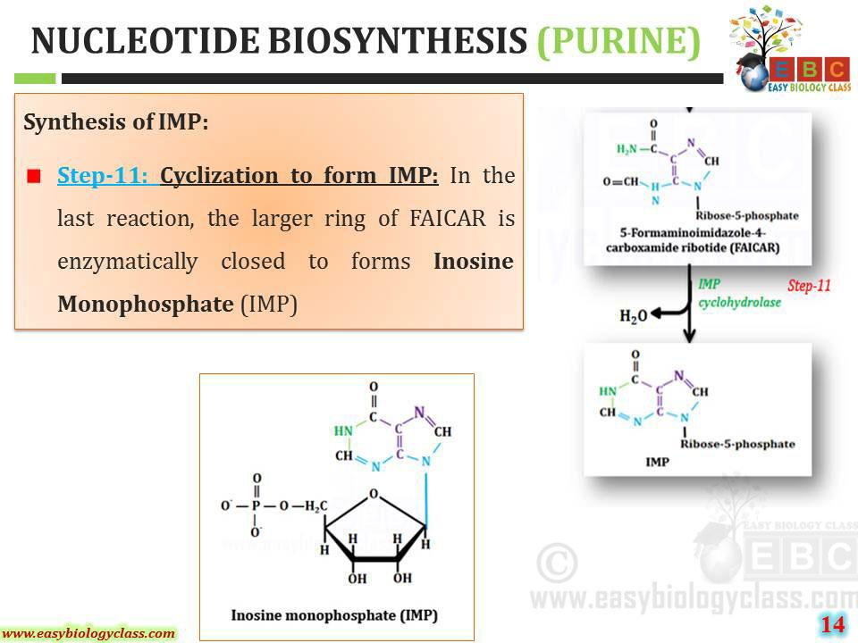

Slide 24
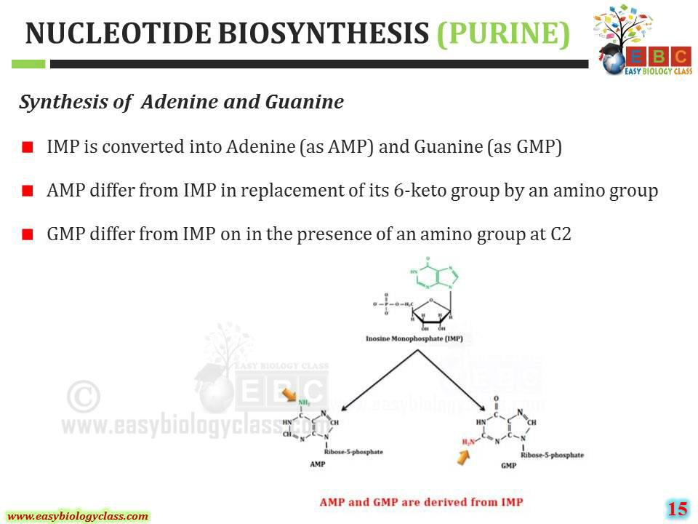

Slide 25
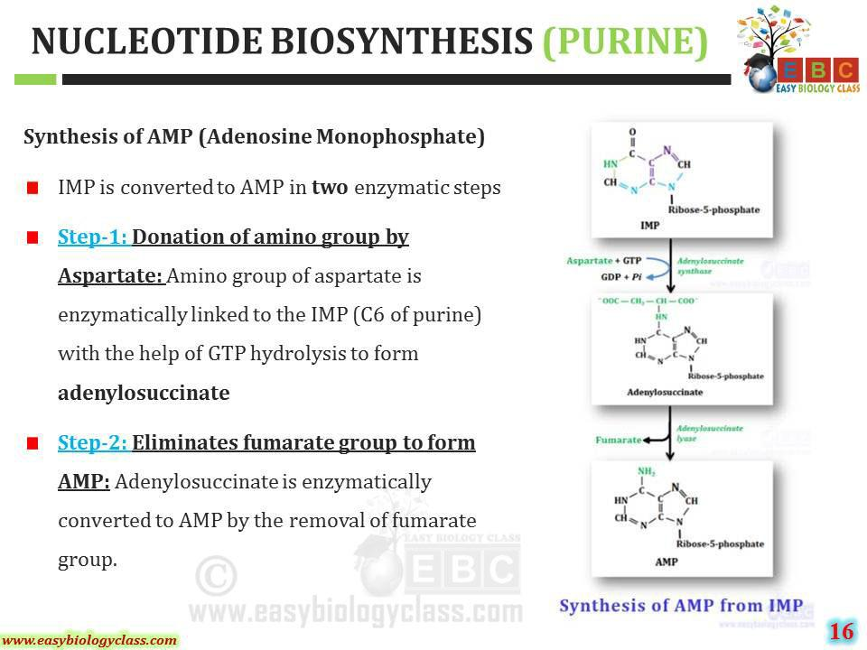

Slide 26
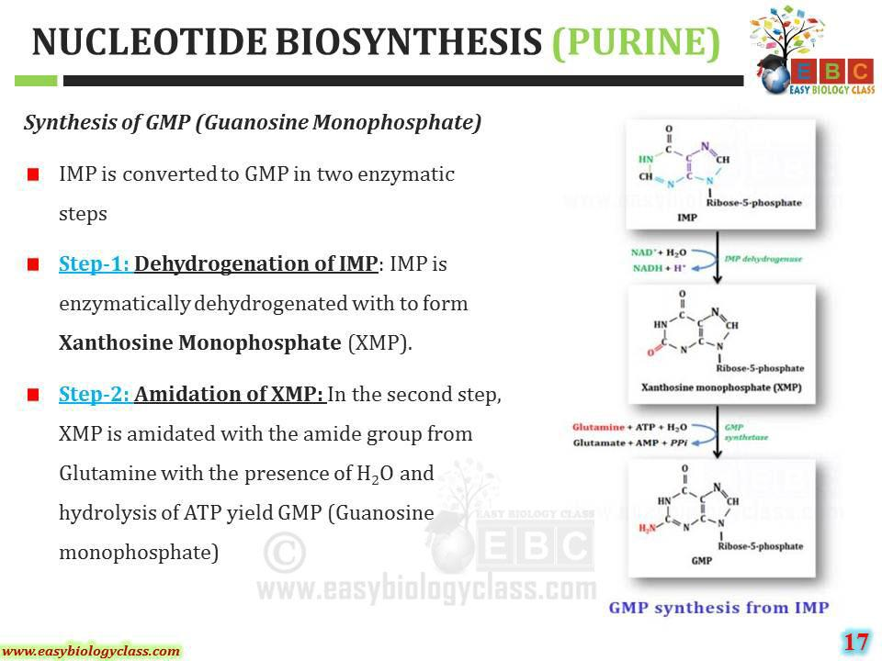

Slide 27
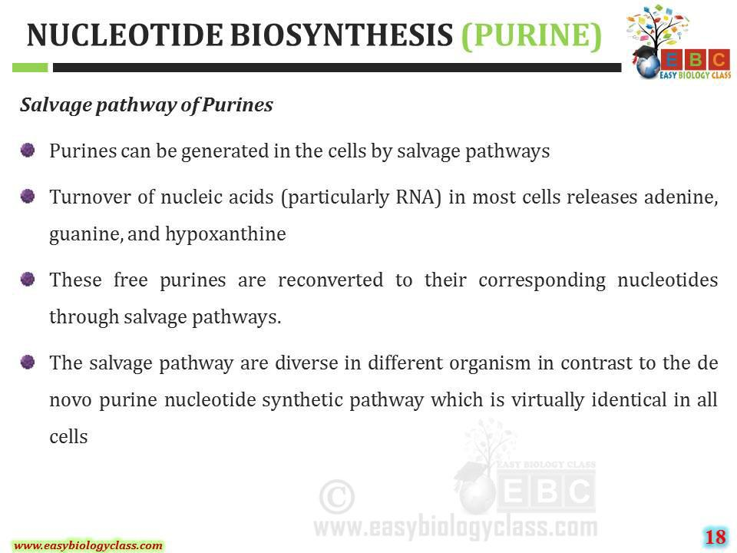

Slide 28
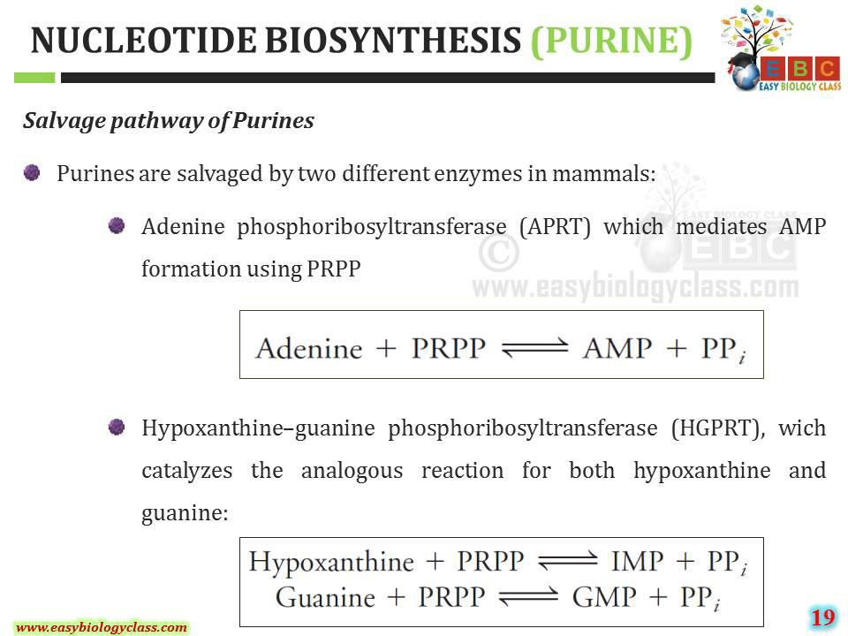

Slide 29
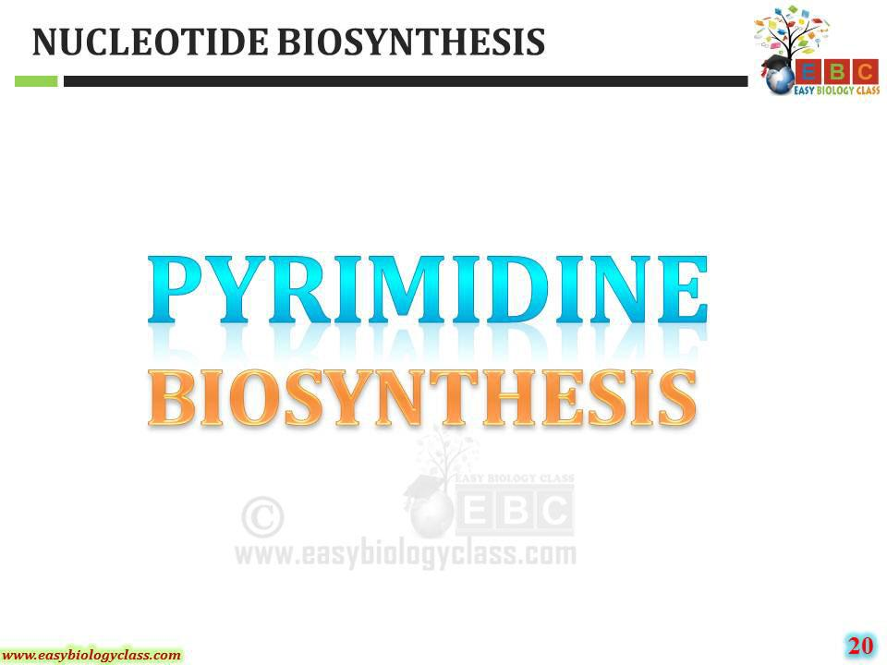

Slide 30
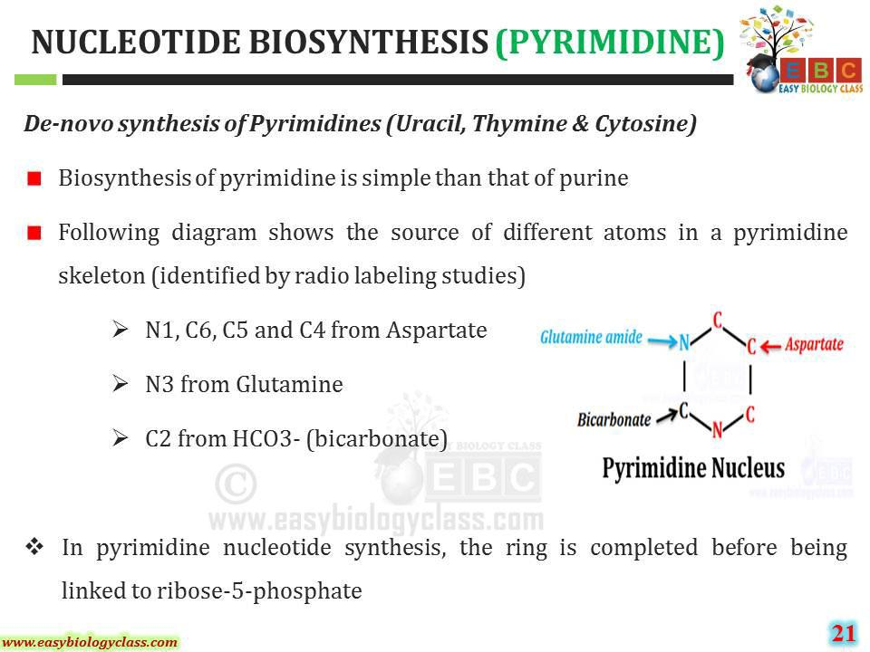

Slide 31
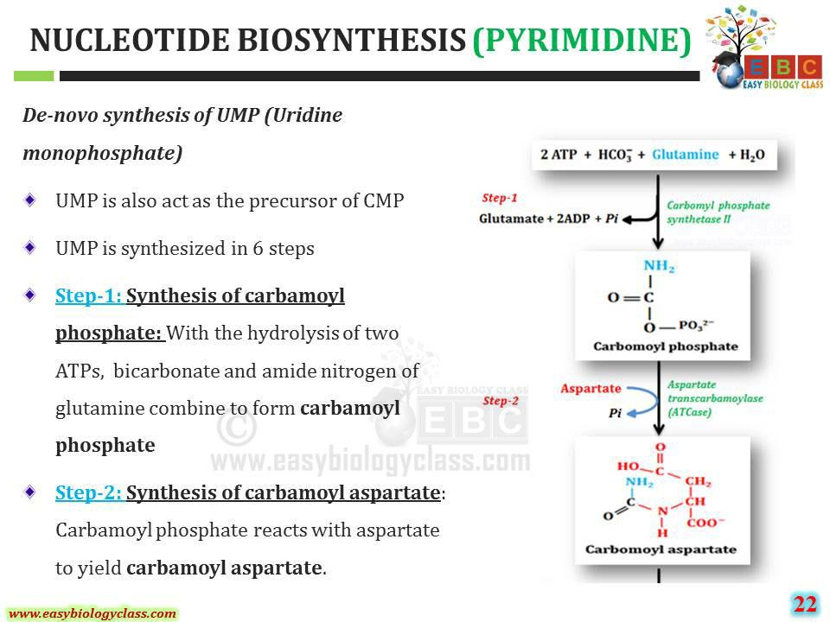

Slide 32
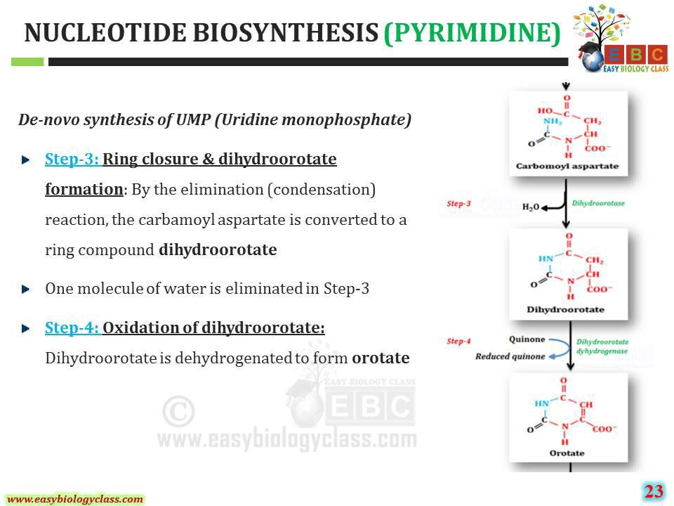

Slide 33
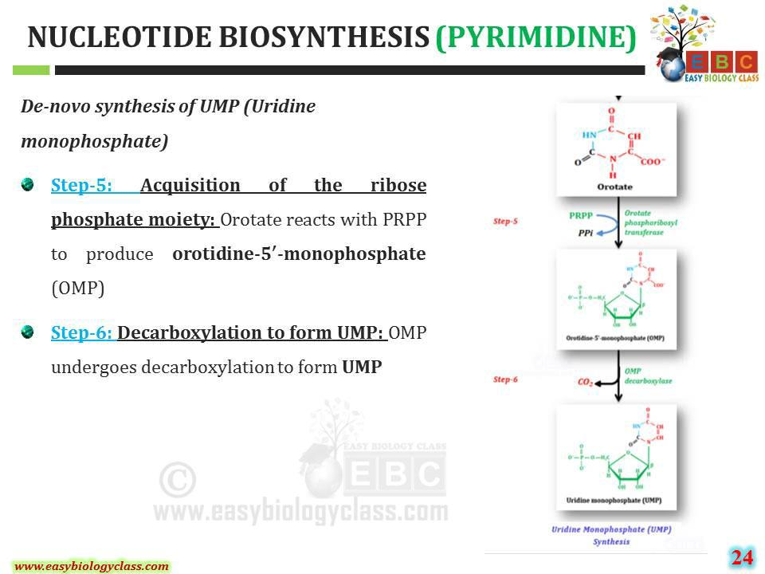

Slide 34
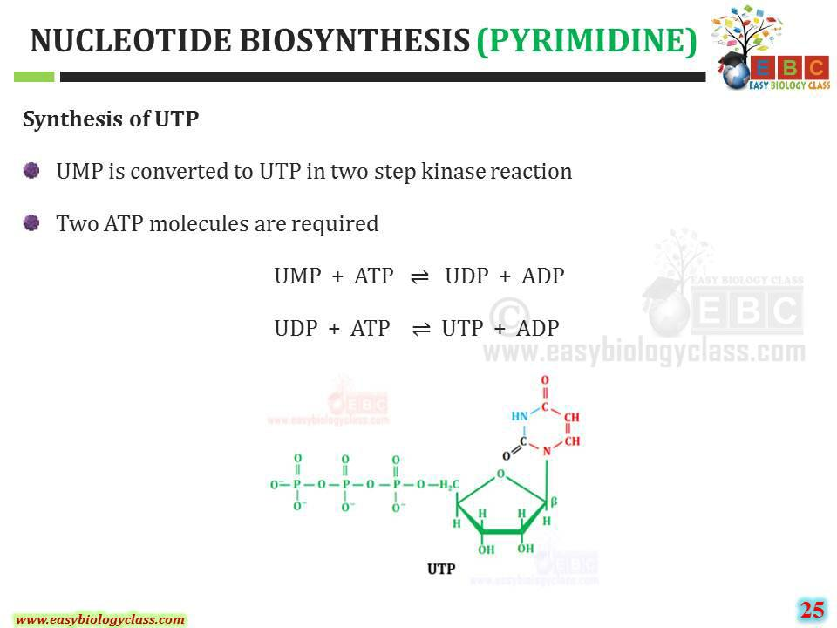

Slide 35
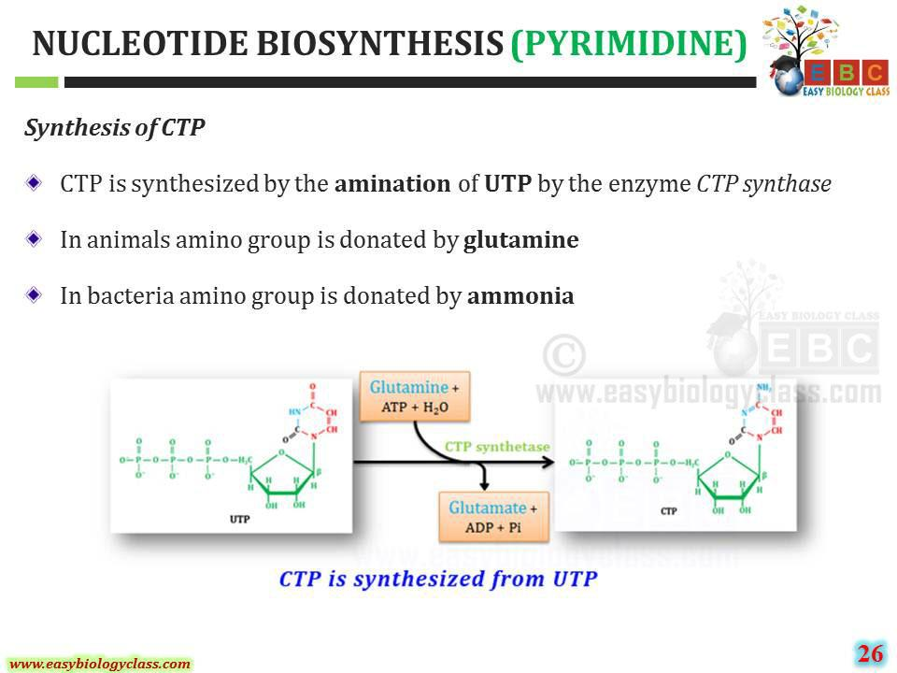

Slide 36
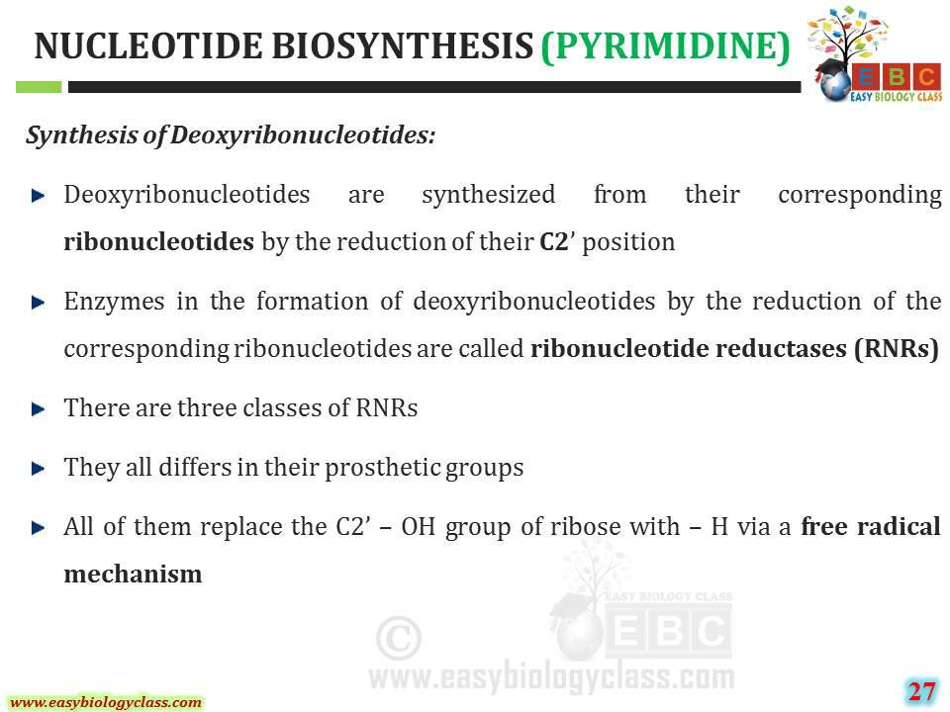

Slide 37
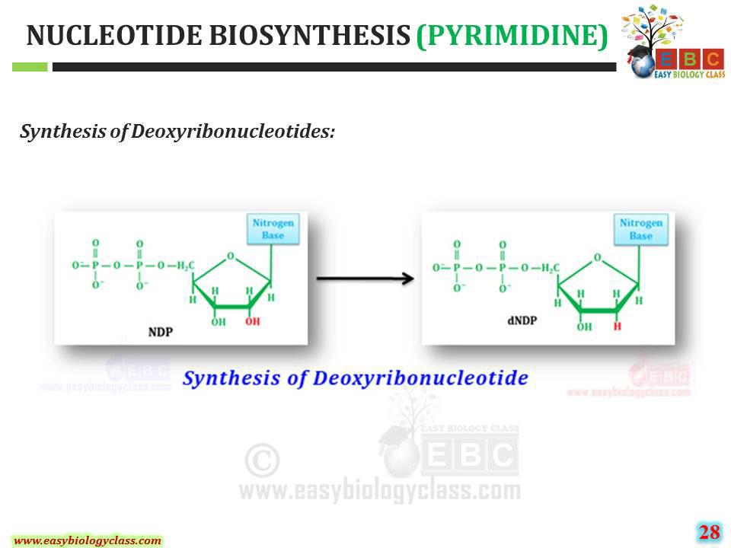

Slide 38
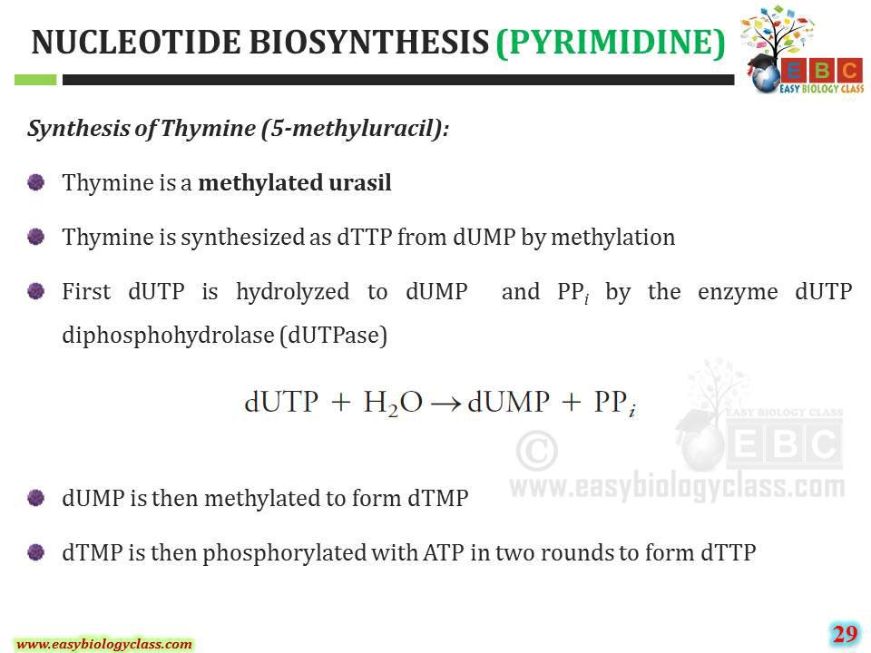

Slide 39
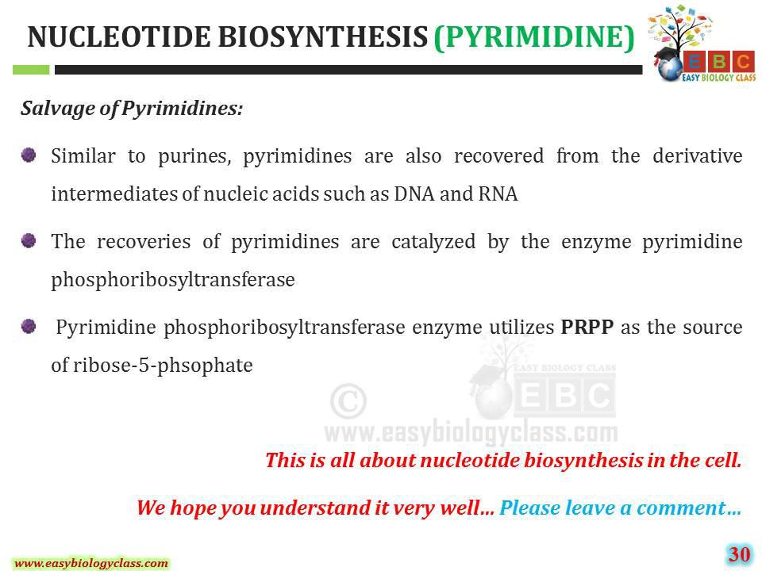

Slide 40
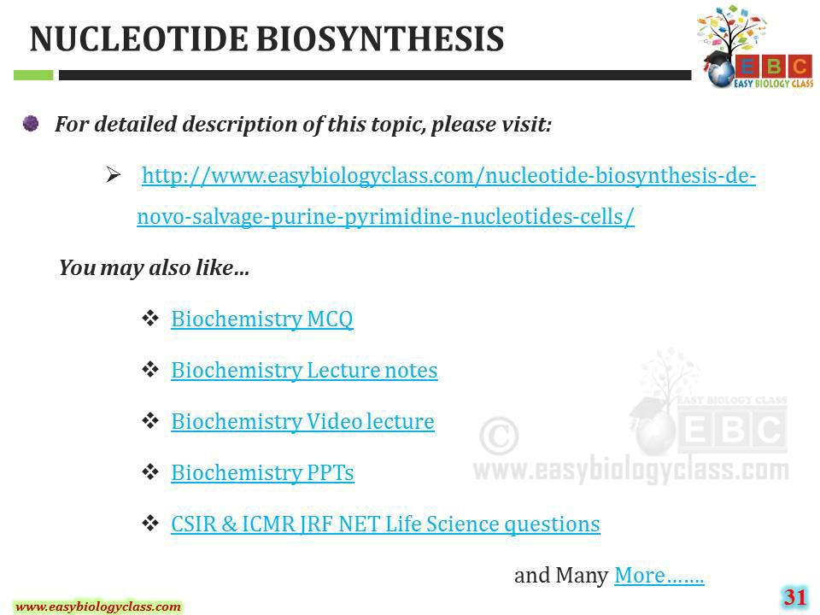

Slide 41
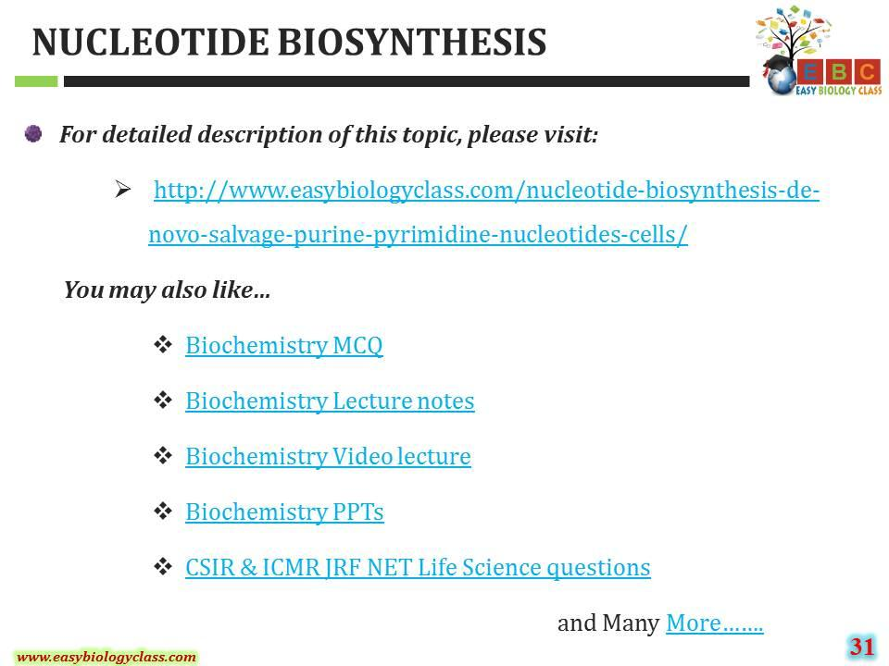

Slide 42

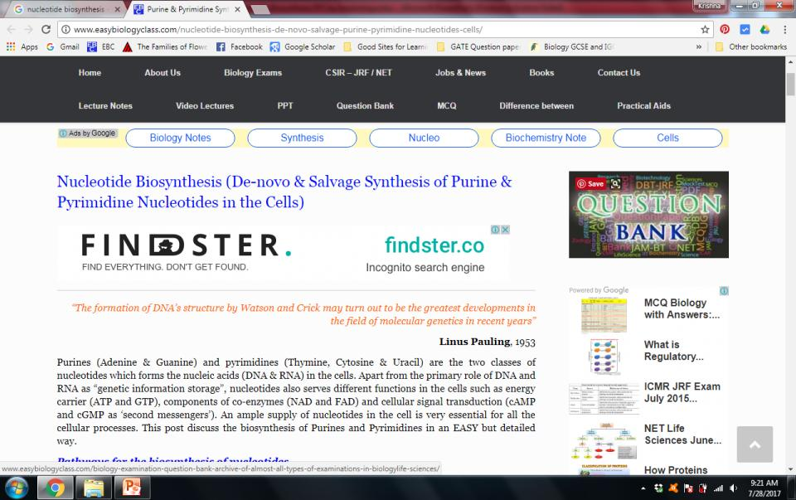
For detailed description of this topic, please click on:
http://www.easybiologyclass.com/nucleotide-biosynthesis-de-novo-salvage-purine-pyrimidine-nucleotides-cells/

Slide 43



Visit our website: www.easybiologyclass.com for:
  Lecture notes
  Video tutorials
  Biology PPTs
  Biology MCQs
  CSIR and GATE Study Materials
  Job Notifications
  Question Bank
  Many more…
Our sister concern: www.angiospermtaxonomy.com

Slide 44




For more information, please log on to: www.easybiologyclass.com
For video tutorials : easybiologyclass
Download PPT : Slideshare
Thank You…
E-mail:
easybiologyclass@gmail.com
mail@easybiologyclass.com
visit: www.easybiologyclass.com

